Slide 1


Introduction to FDI in India
Foreign Direct Investment (FDI) plays a crucial role in India's economic growth. It enhances infrastructure development, creates jobs, and boosts technology transfer. This report analyzes FDI trends, sectoral distribution, and challenges from 2000 to 2017.

Slide 2

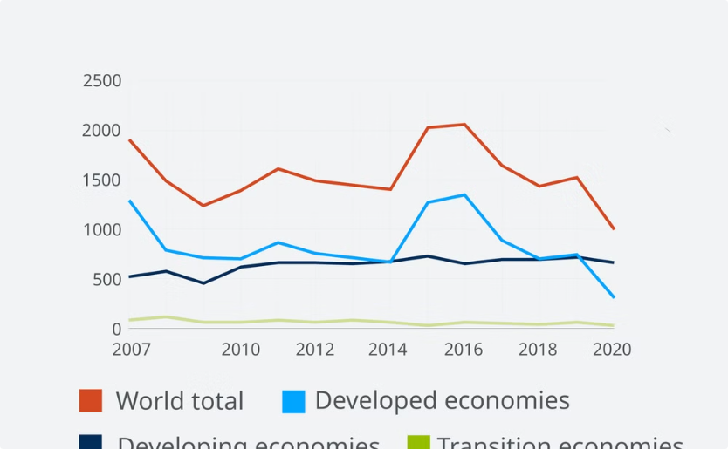
FDI Trends in India (2000-2017)
Growth Over the Years
Annual Fluctuations
FDI inflows to India surged from $4 billion in 2000 to over $40 billion in 2017.
While 2006 witnessed peak investments, global economic conditions caused fluctuations.

Slide 3
Sectoral Analysis of FDI Inflows
Services Sector
Manufacturing
Infrastructure
This sector attracted over 30% of total FDI inflows, highlighting its importance.
Manufacturing received significant investment, especially in the automobile and textile industries.
Investments in infrastructure like energy, telecom, and transportation grew steadily.

Slide 4


Top Investing Countries
FDI Inflows ($ Billion)
Percentage of Total
Country
U.S.A
20
25%
Singapore
15
18%
United Kingdom
10
12%

Slide 5

Regional Distribution of FDI
1
Eastern Region
2
Western Region
This region saw substantial manufacturing investment due to favorable policies.
Major services and technology firms are concentrated here, driving FDI.
3
Southern Region
Information technology and pharmaceuticals have attracted notable investment.

Slide 6

Factors Driving FDI Inflows
1
Government Policy
Liberalization and 'Make in India' initiative significantly improved investment climate.
2
Market Potential
India's large consumer base draws foreign investors interested in diverse markets.
3
Skilled Workforce
Availability of skilled labor enhances India's attractiveness for investment.

Slide 7




Challenges and Barriers to FDI
Regulatory Hurdles
Complex regulations deter potential investors.
Infrastructure Gaps
Poor infrastructure impacts business operations and delivery times.
Political Stability
Policy changes and political risks can lead to uncertainty.

Slide 8


Conclusion and Key Takeaways
FDI in India has witnessed substantial growth, contributing significantly to the economy. Despite challenges, government initiatives and market potential offer vast opportunities.

